Slide 1
How to build a SSO bot using yo teams for Microsoft Teams

Slide 3
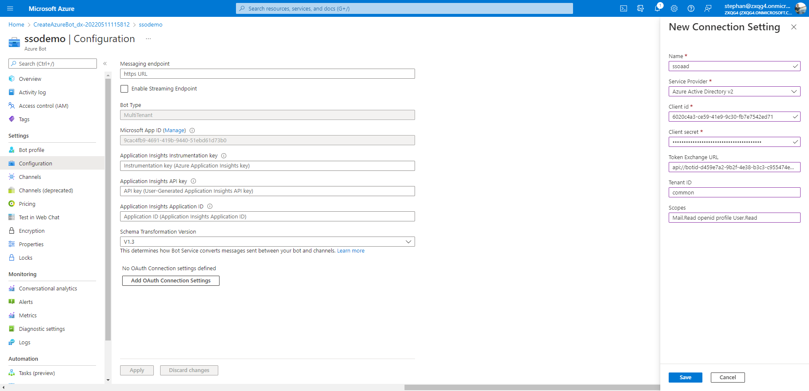
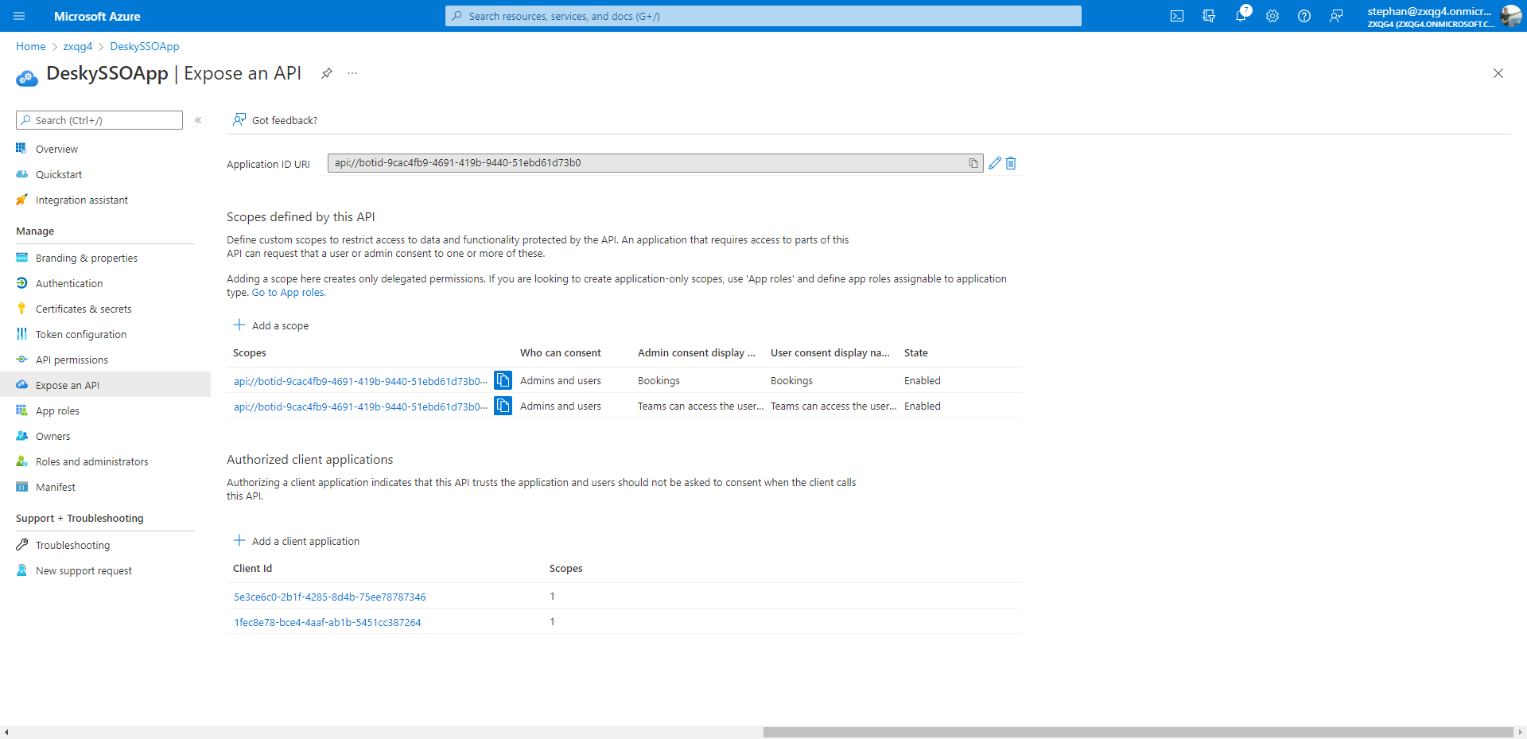
What you’ll need
yo teams (aka.ms/yoteams)
Azure Bot
Azure AD App registration

Slide 4
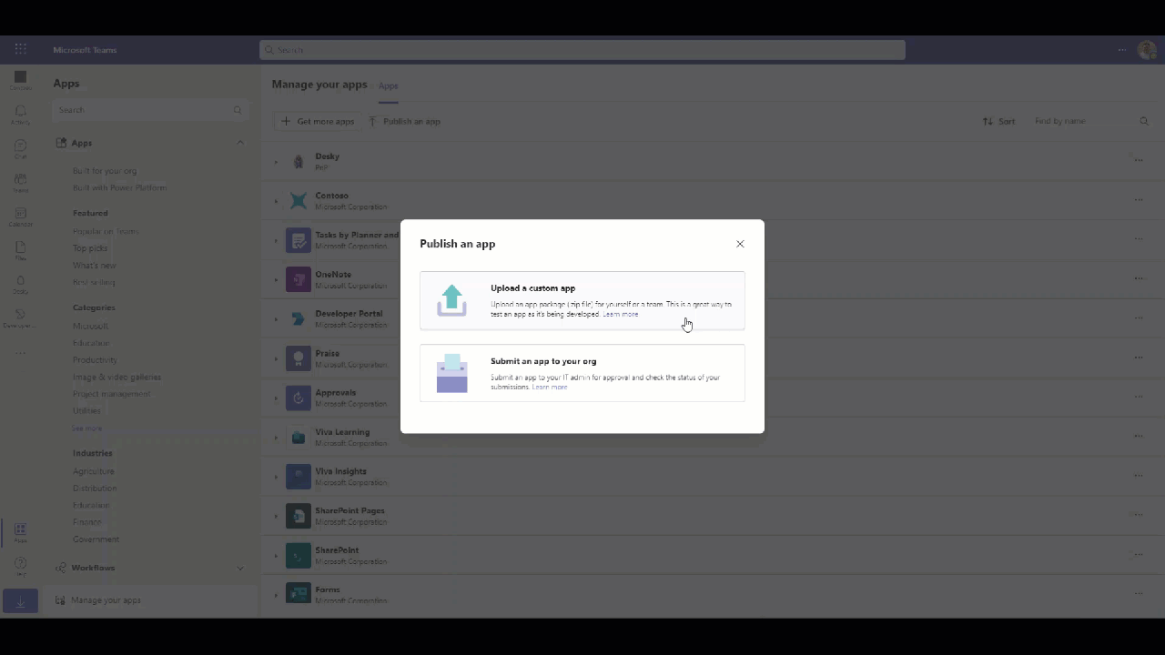

Slide 5
Links & resources
https://aka.ms/yoteams
https://docs.microsoft.com/en-us/learn/modules/msteams-sso/6-bots-sso
https://github.com/OfficeDev/TrainingContent/tree/master/Teams/80%20Using%20Single%20Sign-On%20with%20Microsoft%20Teams/Demos/02-learn-msteams-sso-bot
https://docs.microsoft.com/en-us/microsoftteams/platform/bots/how-to/authentication/auth-aad-sso-bots

